Slide 1
CRUD express
Gabriel Mina

Slide 2
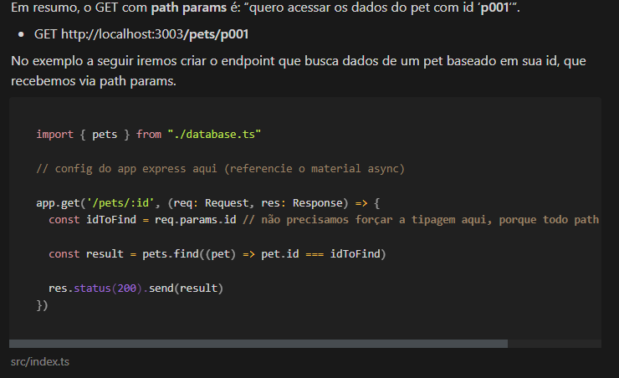

Slide 3


Slide 4
